Slide 1


OBJECTIVE
To introduce the SWITCH model as a framework to look at behaviour change.
TOOL
THE SWITCH MODEL
THE FINLAB TOOLKIT

Slide 2
ABOUT ‘SWITCH MODEL’
The Switch Model is a widely used framework to help guide behaviour change approaches - especially in the behaviour change communication domain.
Similar to the NUDGE framework, it goes beyond complex choices and focuses on what it takes to create sustainable behaviour change.
The model proposes that there are three elements to the behaviour of a person - the rational side (The Rider), the emotion side (The Elephant), and the environment (The Path).
THE FINLAB TOOLKIT

Slide 3
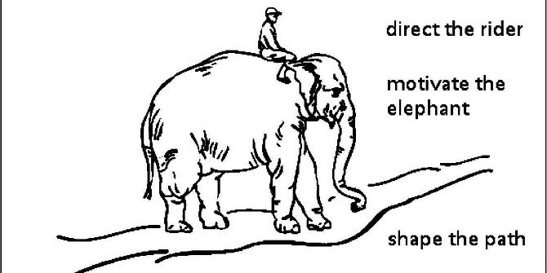
Existing Behaviour
New
Behaviour
THE FINLAB TOOLKIT

Slide 4
Direct The Rider
What looks like resistance is often a lack of clarity - provide a crystal clear direction to the rational side (The Rider) of a person who is to adopt a behaviour.
Motivate The Elephant
What looks like laziness is often exhaustion. The Rider can’t get his way by force for very long - it is critical to engage a person’s emotion side (The Elephant).
Shape The Path
What looks like a people problem is often a situation problem. When one changes the situation/environment/context (The Path), often it makes it easier for the Rider and Elephant to follow.
THE FINLAB TOOLKIT

Slide 5
DIRECT THE RIDER
FOLLOW THE
BRIGHT SPOTS
Build on existing positive behaviour and success stories rather than focusing energy on fixing the problematic areas. Learn from, and scale positives.
What is working? Who is it working for? How is it working? What can we clone, copy, or build on?
THE FINLAB TOOLKIT

Slide 6
DIRECT THE RIDER
SCRIPT THE
CRITICAL MOVES
Think in terms of specific behaviours, don’t focus on the bigger picture. Dissolve the ambiguity.
What specific behaviours can we focus on? How can these specific behaviours contribute to bigger change?
THE FINLAB TOOLKIT

Slide 7
DIRECT THE RIDER
POINT TO THE DESTINATION
Paint a picture of what the end point will be, what change will look like. Create a specific goal that people can work towards and respond to.
What is the vision for change? What does it look like? What would be the goals that change would achieve?
THE FINLAB TOOLKIT

Slide 8
MOTIVATE THE ELEPHANT
FIND THE
FEELING
Knowing something isn’t enough to cause change.
Make people feel something. Focus on positive motivation rather than just negative reinforcement.
What feelings drive the need for change? What are negative feelings? What are positive feelings? How to focus on positive motivation?
THE FINLAB TOOLKIT

Slide 9
MOTIVATE THE ELEPHANT
SHRINK THE
CHANGE
Break down the change until it no longer seems daunting. Provide people with a sense of accomplishment of successfully affecting change in small ways.
How can one get started? How can the steps be kept simple and achievable? How can we create a sense of accomplishment soon?
THE FINLAB TOOLKIT

Slide 10
MOTIVATE THE ELEPHANT
GROW YOUR
PEOPLE
Cultivate a sense of identity and instill the growth mindset. Elevate them to bring about change by equipping them with the knowledge and skills and most importantly, the confidence to complete change.
How do we provide confidence to people? How do we equip them with skills, knowledge, tools which are helpful to them?
THE FINLAB TOOLKIT

Slide 11
SHAPE THE PATH
TWEAK THE
ENVIRONMENT
When the situation changes, the behavior changes. So change the situation. Observe, explore and tackle bottlenecks.
How can we realise behaviour change by changing something about the context, situation, and journey itself? What can we simplify and create ease of use?
THE FINLAB TOOLKIT

Slide 12
SHAPE THE PATH
BUILD HABITS
When behavior is habitual, it’s “free” and doesn’t tax the Rider. Look for ways to encourage habits. Habits help build long term change.
How do we facilitate new behaviours to become habits? How do we make it consistent? How do we make it visible and accountable?
THE FINLAB TOOLKIT

Slide 13
SHAPE THE PATH
RALLY THE HERD
Behavior is contagious. Help it spread. Get people involved. Move it beyond individuals. Get changed recognised and adopted by other people.
How do we spread the behaviour from individuals to a group? How do we get sanction from others? How do we get others excited?
THE FINLAB TOOLKIT

Slide 14
HOW TO USE?
Current Behaviour and Challenge: Desired Behaviour Change and Impact:
Direct the Rider | Rationale
FOLLOW THE BRIGHT SPOTS What is working? Who is it working for? How is it working? What can we clone, copy, or build on?
SCRIPT THE CRITICAL MOVES What specific behaviours can we focus on? How can these specific behaviours contribute to bigger change?
POINT TO THE DESTINATION What is the vision for change? What does it look like? What would be goals that change would meet?
Motivate the Elephant | Emotion
FIND THE FEELING What feelings drive need for change? What are negative feelings? What are positive feelings? How to focus on positive motivation?
SHRINK THE CHANGE How can one get started? How can the steps be kept simple and achievable? How can we create a sense of accomplishment soon?
GROW YOUR PEOPLE How do we provide confidence to people? How do we equip them with skills, knowledge, tools helpful to them?
Shape the Path | The Environment
TWEAK THE ENVIRONMENT How can we realise behaviour change by changing something about the context, situation, journey itself? What can we simplify and create ease?
BUILD HABITS How do we facilitate new behaviour to become habits? How do we make it consistent? How do we make it visible and accountable?
RALLY THE HERD How do we spread the behaviour from individuals to a group? How do we get sanction from others? How do we get others excited?
1
Current & Desired Behaviour
Note down: The current behaviours and the challenge they create, and the ideal behaviour after change and its impact.
Rider, Elephant, Path
Note down: Findings and Ideas under each of the specific switches.
2
THE FINLAB TOOLKIT

